Slide 1
Linear Implementation Proposal
Alexandra Beno
Student ID 011095454
C768 PA Task 3

Slide 2
Agenda
Introduction
Problem
What is Linear?
How can Linear help?
Wrap Up

Slide 3
Introduction
Beno Software Company
More than 500 Clients
2,000 employees
Goal: Improve issue and project tracking

Slide 4



The Problem
Current issue tracking is inconsistent
Different tools and methods
Leads to:
Disorganization
Missed updates
Increased workload
Image credits:
(Trello, n.d.)
(Github, n.d.)
(Jira, n.d.)

Slide 5
“Linear has become the go-to tool for startups and high-growth tech companies looking to escape the complexity of legacy project management systems.”
(Siit, n.d.)

Slide 6
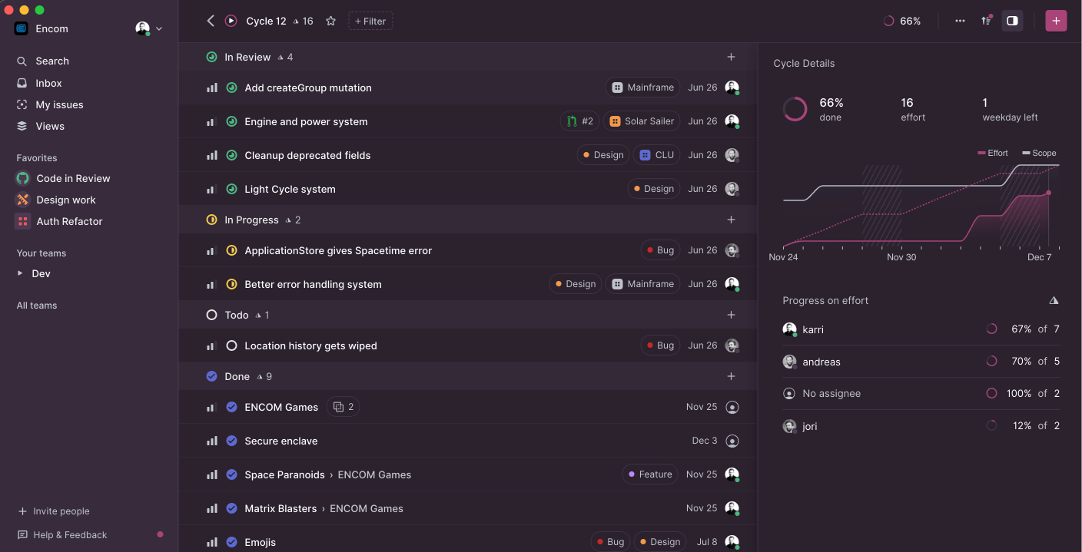
What is Linear?
Web-based issue and project tracking
Designed for collaboration and simplicity
Features:
Real-time sync
AI Agents
Clean, intuitive design
Image Credit: (Linear, n.d.)

Slide 7
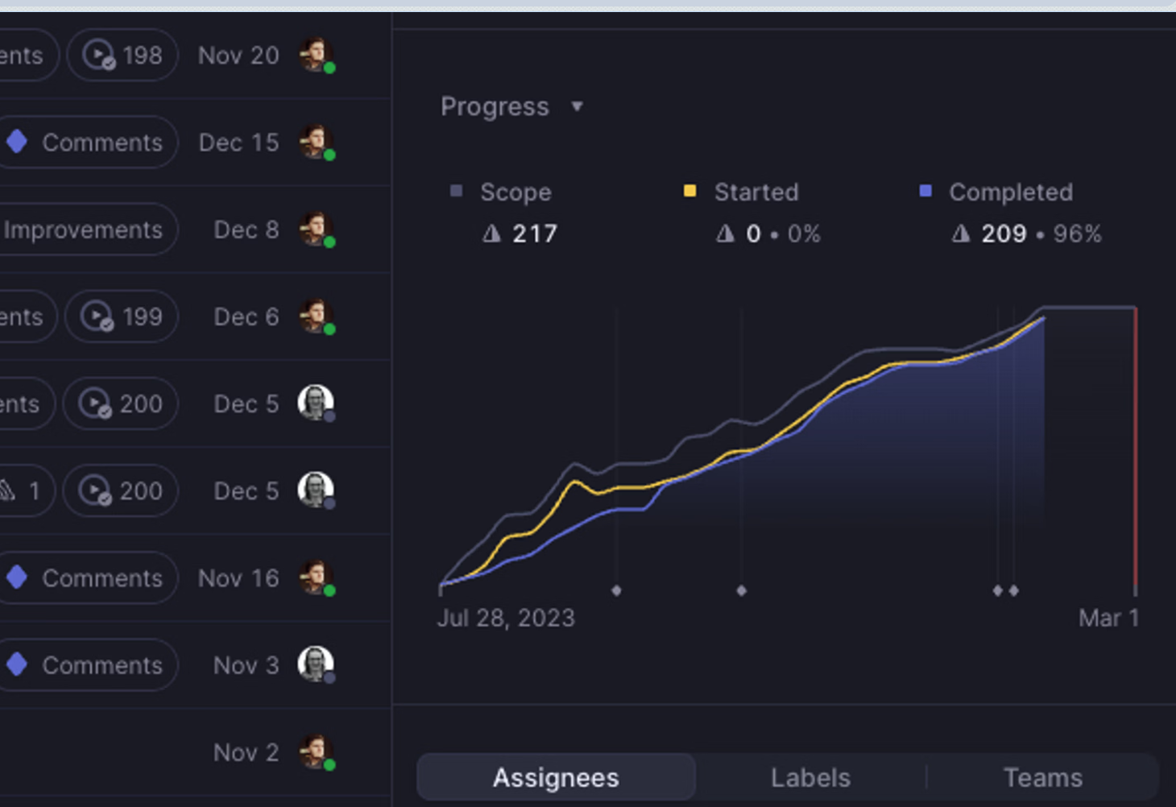
How can Linear help?
Centralized system
Automate repetitive tasks
Improve communication
Enable improved project management
Easy to learn
Highly scalable
Image Credit: (Linear, n.d.)

Slide 8
Wrap up

Slide 9
Sources
Siit, (n.d.). Linear App Review: Features, Pricing, Pros & Cons. https://www.siit.io/tools/trending/linear-app-review
Linear, (n.d.). Linear - Plan and Build Products. https://linear.app
Trello, (n.d.). Capture, organize, and tackle your to-dos from anywhere | Trello. https://trello.com/
Github, (n.d.). Github – Build and ship software on a single, collaborative platform. https://github.com/
Jira, (n.d.). Jira | Issue and Project Tracking Software. https://www.atlassian.com/software/jira

